Slide 1
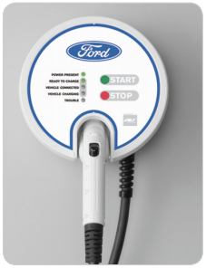

FORDCS-V1.0-Architecture Design
EDU Project
karacankos@gmail.com
https://www.linkedin.com/in/omer-karacan/
https://www.instagram.com/karacanos/

Slide 2
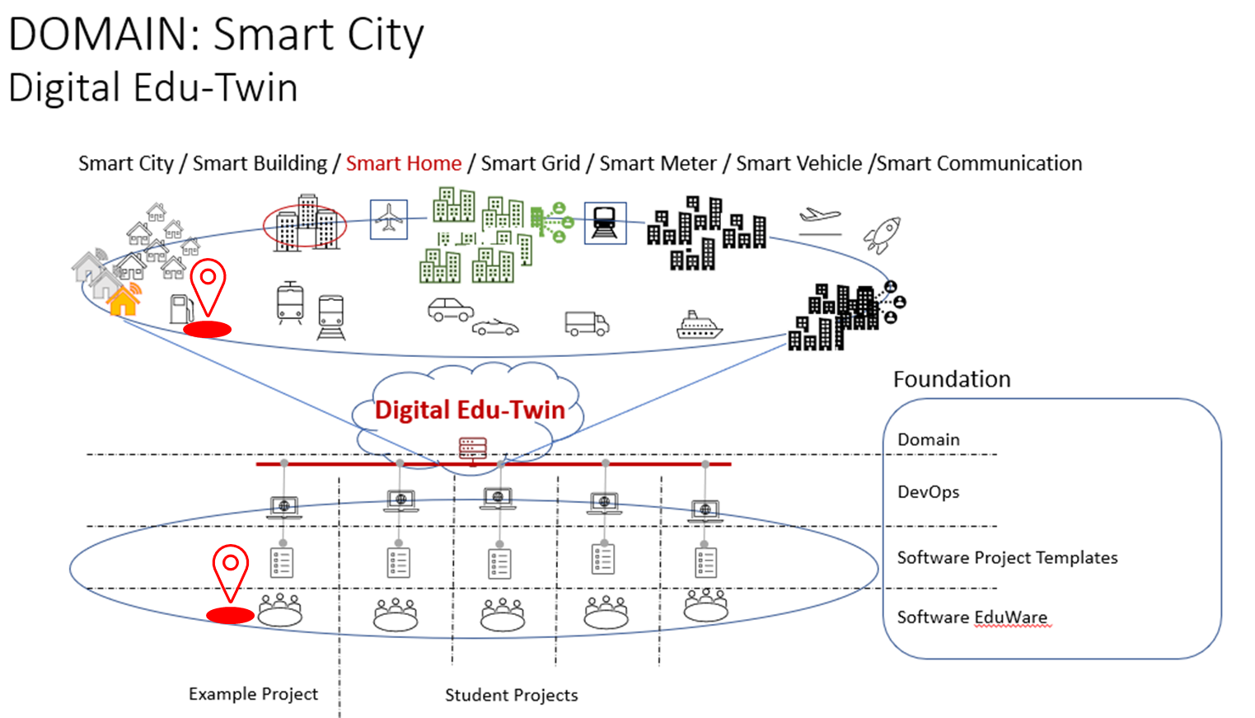

Project Context

Slide 3



FORD CHARGing Station ApplIcatIon Architecture Pattern
<SpringBootApplication,
charging-station-application>
fordcs
<Repository>
fordcsRepository
<Service>
fordcsService
<Controller>
fordcsController
Tester
Java Persistence (JAP) API
<embedded-db>
Hibernate
Developer
<persistency>
data storage
<algorithm>
business logic
<endpoints>
fordcs APIs

Slide 4
USE CASE Report Factory Setting V1.0
<Repository>
FactorySetting Repository
Controller/Service/Repository component design
Service Endpoint
System Test tools
<Service>
FactorySetting Service
https://api.example.com/v1/reportCsFactorySetting
GET
Returns FordCSSettingDataX
<Controller>
FactorySetting Controller
curl
Source: https://app.swaggerhub.com/apis/karacankos/fordcs/1.0-oas3

Slide 5
Data Structure Design : FordCSSettingDataX

Slide 6
BACKYARD
Wichtige Informationen

Slide 7



FORD CHARGing FUTURE Front ends and external DB
<SpringBootApplication,
charging-station-application>
fordcs
<external-db>
UX/UI
<Repository>
fordcsRepository
<Service>
fordcsService
<Controller>
fordcsController
Java Persistence (JAP) API
<embedded-db>
Hibernate
<persistency>
data storage
<algorithm>
business logic
<endpoints>
fordcs APIs

Slide 8
Readings
CHECK: https://objectbox.io/how-ev-charging-benefits-from-edge-computing/

